Slide 1




Virtual Pet Simulator

Slide 2
Small Audience
Individuals with allergies or space constraints
Busy professionals or students
Prospective Pet owners
Notes:
Individuals with Allergies or Space Constraints:
Target Group: People who cannot have real pets due to allergies, small living spaces, or other constraints.
Need: They seek the companionship and responsibility of pet care but face physical or health limitations.
VPM Solution: The VPM provides a virtual alternative, allowing these individuals to experience pet ownership without the physical or health-related challenges. By offering customizable and interactive virtual pets, the VPM satisfies their desire for companionship and engagement.
Busy Professionals or Students:
Target Group: Individuals with demanding schedules who may find it challenging to provide consistent care for real pets.
Need: They need a flexible way to engage with pets without the time commitment required by real animals.
VPM Solution: The VPM’s design accommodates their busy lifestyles by allowing users to interact with their virtual pets at their convenience. Features like reminders and routine tracking help manage pet care in a way that fits into their schedules.
Prospective Pet Owners:
Target Group: Individuals considering adopting a real pet but wanting to understand the responsibilities involved before making a commitment.
Need: They need a way to experience pet care and management in a low-risk environment.
VPM Solution: The VPM simulates various aspects of pet care, allowing users to learn about pet management and develop skills that could be valuable when transitioning to real pet ownership. This educational component can help users make informed decisions about adopting a real pet.

Slide 3
High Impact
Emotional Satisfaction
Flexibility and Convenience
Introduction to Pet cair
Notes:
Emotional Satisfaction:
Impact: Users experience emotional fulfillment and companionship through their interactions with virtual pets. The mood gauge and feedback system create a sense of attachment and satisfaction.
Flexibility and Convenience:
Impact: The VPM provides a pet care experience that adapts to users' schedules and living conditions. This flexibility allows users to enjoy pet ownership without the physical or time constraints associated with real pets.
Introduction to Pet Care:
Impact: Users considering real pet ownership gain insights into the responsibilities and challenges of caring for a pet.

Slide 4
User Stories and Prioritisation
Must have user stories
Story ID 1: Create new pet
Story ID 2: customise a pet
Story ID 5: Add new pet to collection
Story ID 9: Feed a pet
Story ID 10: clean a pet
Story ID 16: Account Registration/Login/Logout
Story ID 17: Account Authentication (By Password)
Story ID 18: Saving user’s progress
Acted in accordance with first sprint plan
Pet creation
Basic pet interaction
User account authentication
Basic UI
Notes:
As per the first sprint plan made for this period, the first release focused on:
Pet Creation: Allows users to create and customise pets
Basic Pet Interaction: Provide basic care functions (feed and clean)
User account authentication: Enable user registration and login, and progress saving
Basic UI: Implement a clean, basic prototype UI for managing pets and user accounts.
Consequently, the user stories that were prioritised as must have and implemented were:
Pet Creation and Customization:
Story ID 1: Create a new pet
Story ID 2: Customize a pet
Story ID
Story ID 5: Add a new pet to the collection
Pet Care and Interaction:
Story ID 9: Feed a pet
Story ID 10: Clean a pet
User Account:
Story ID 16: Account Registration/Login/Logout
Story ID 17: Account Authentication (By Password)
Story ID 18: Saving user’s progress

Slide 5
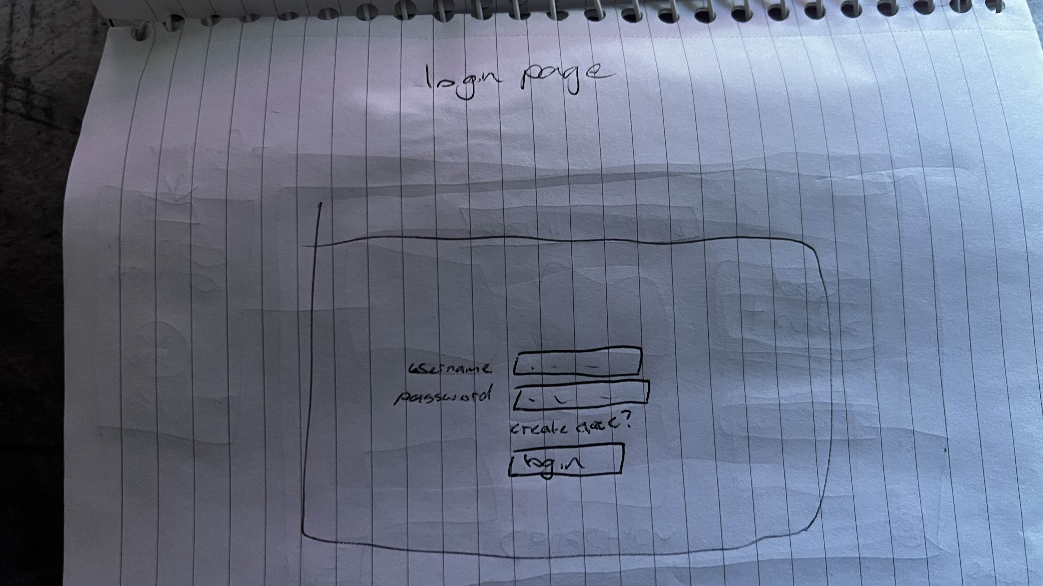
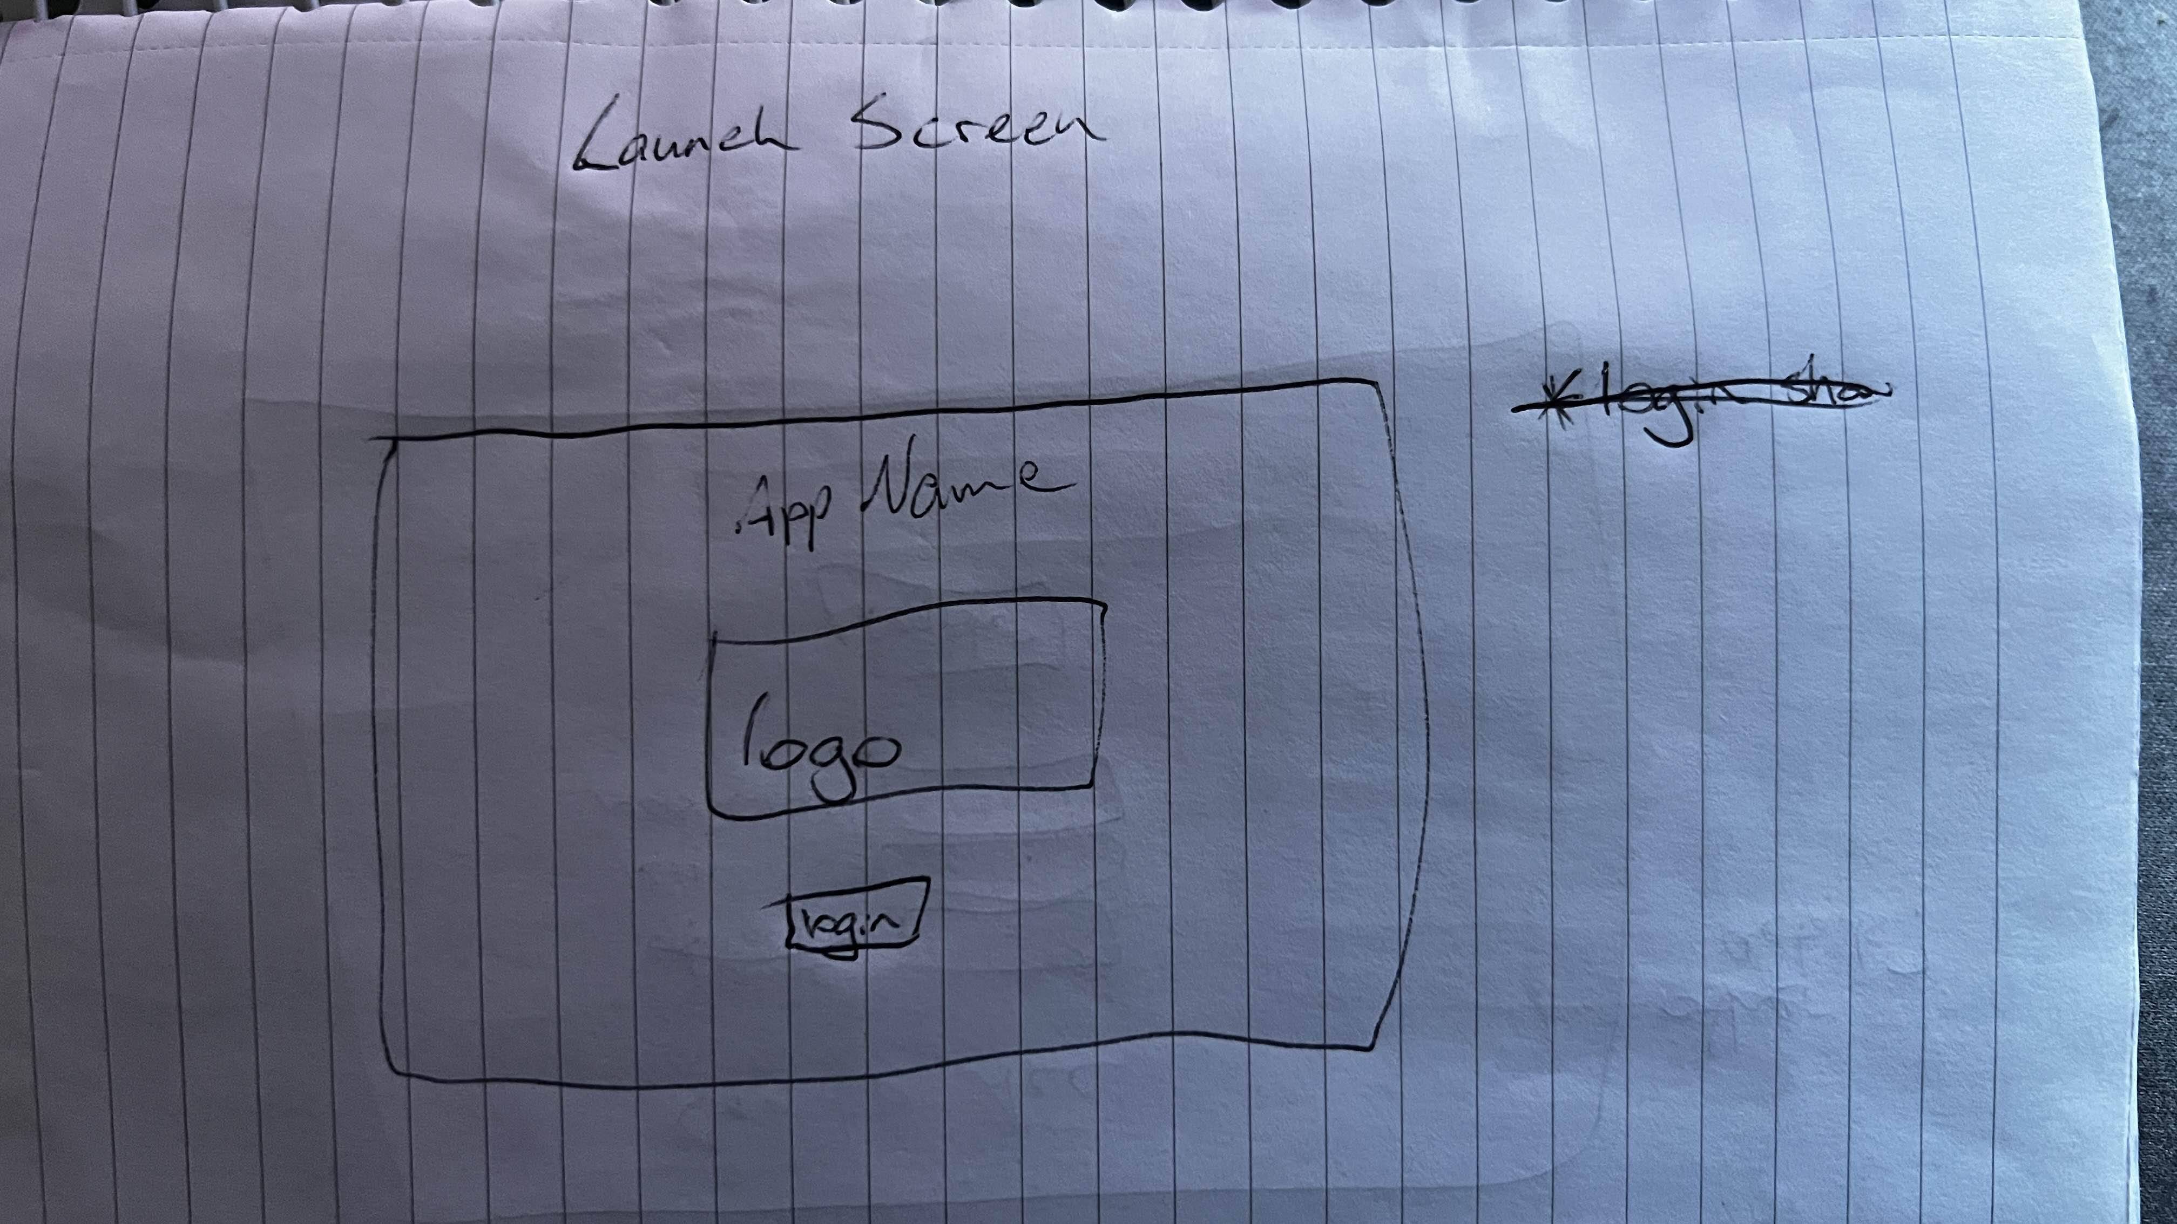
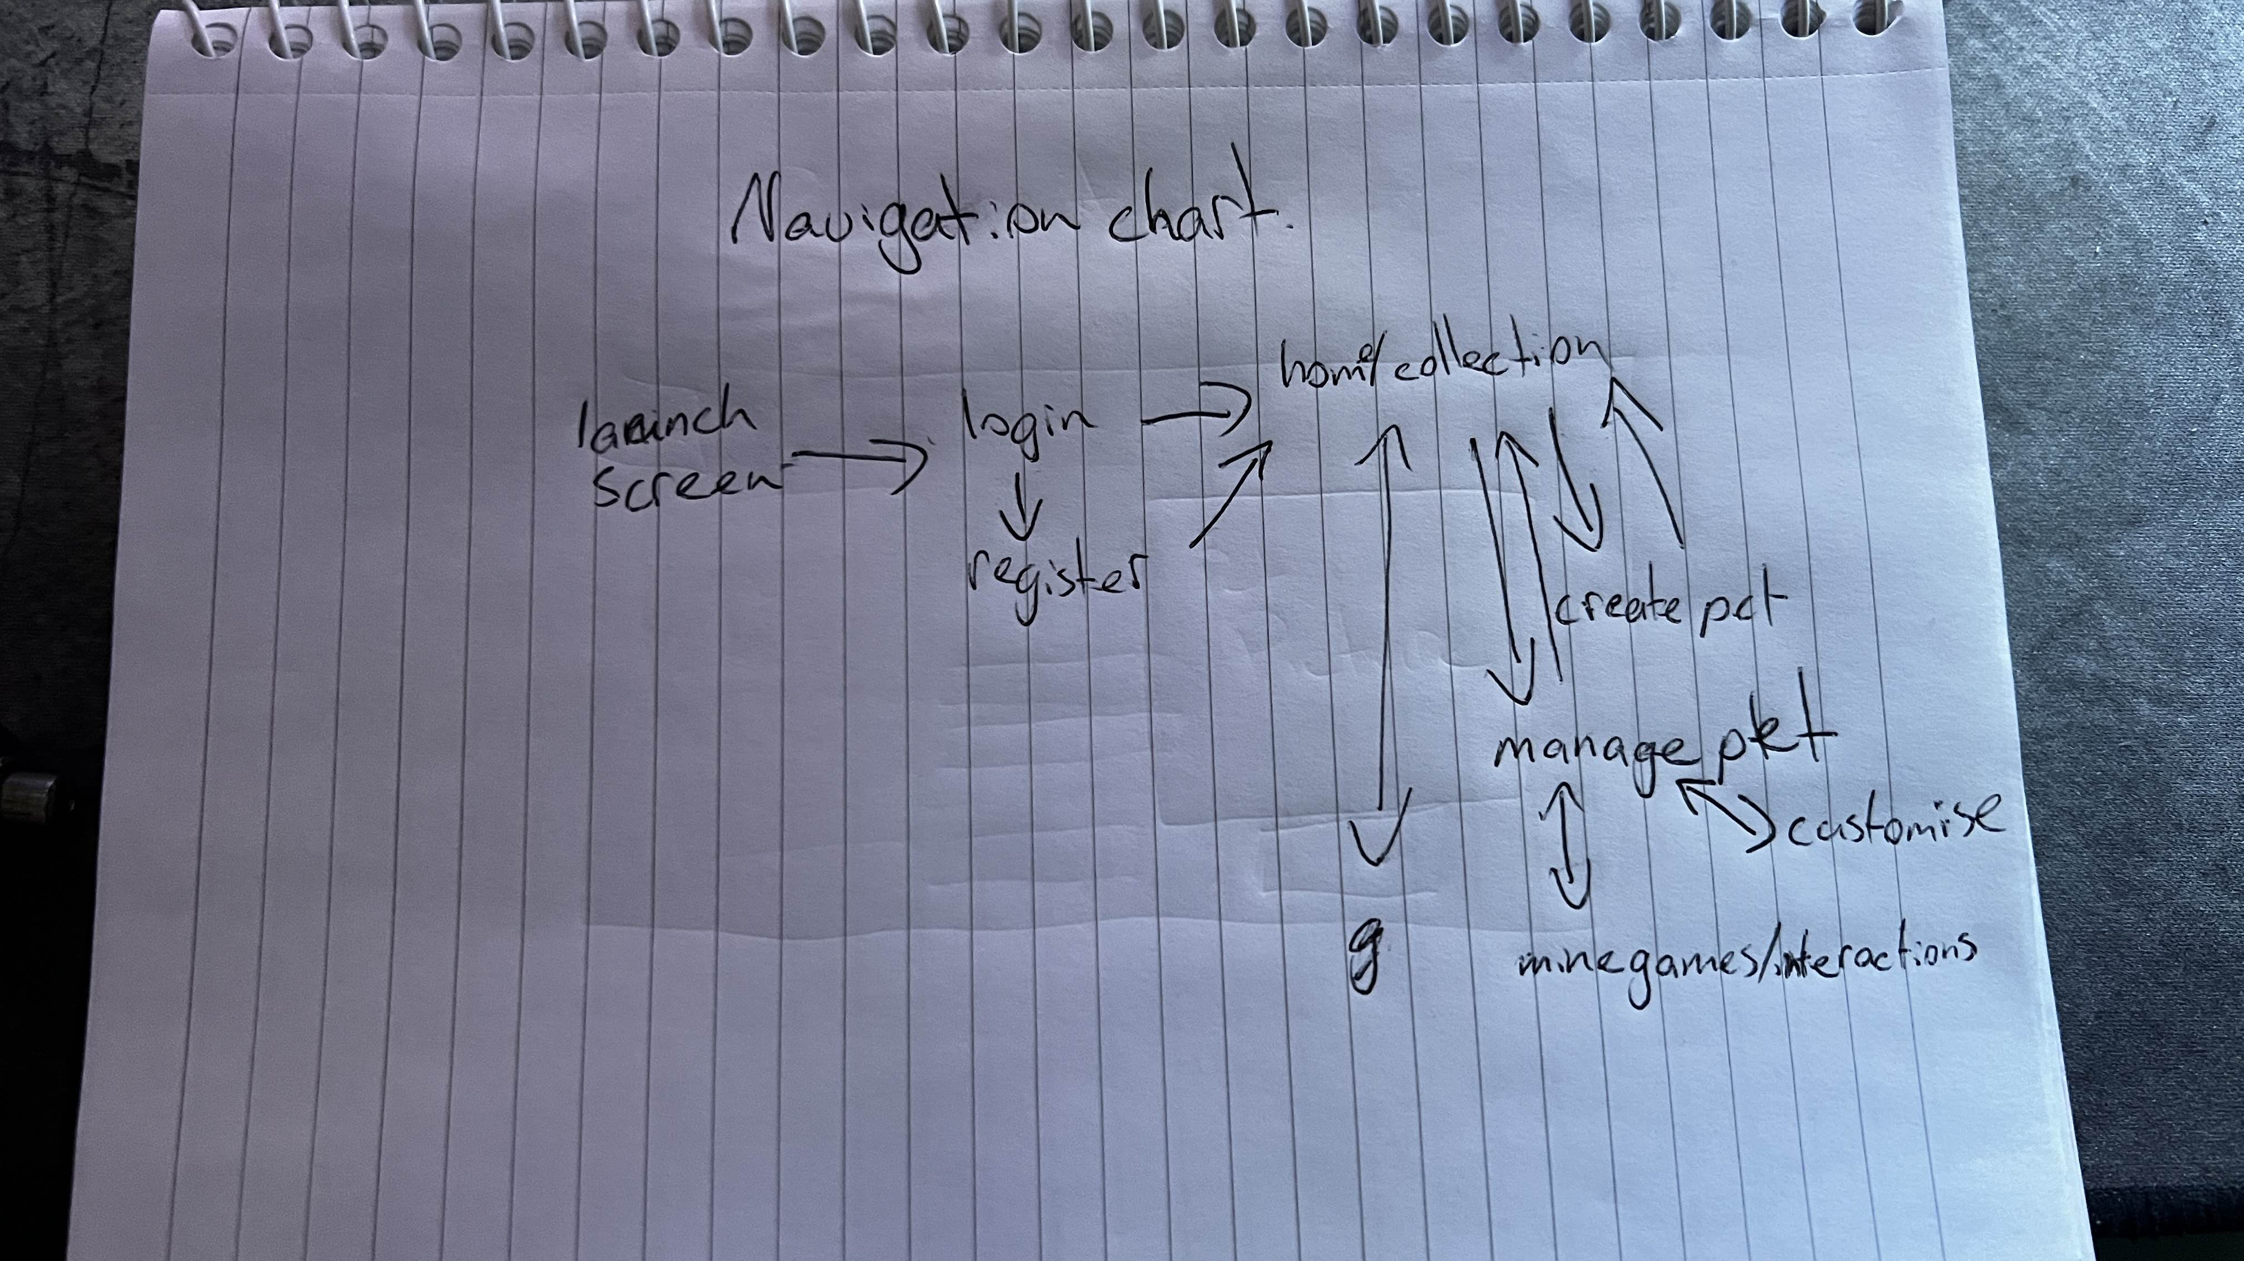
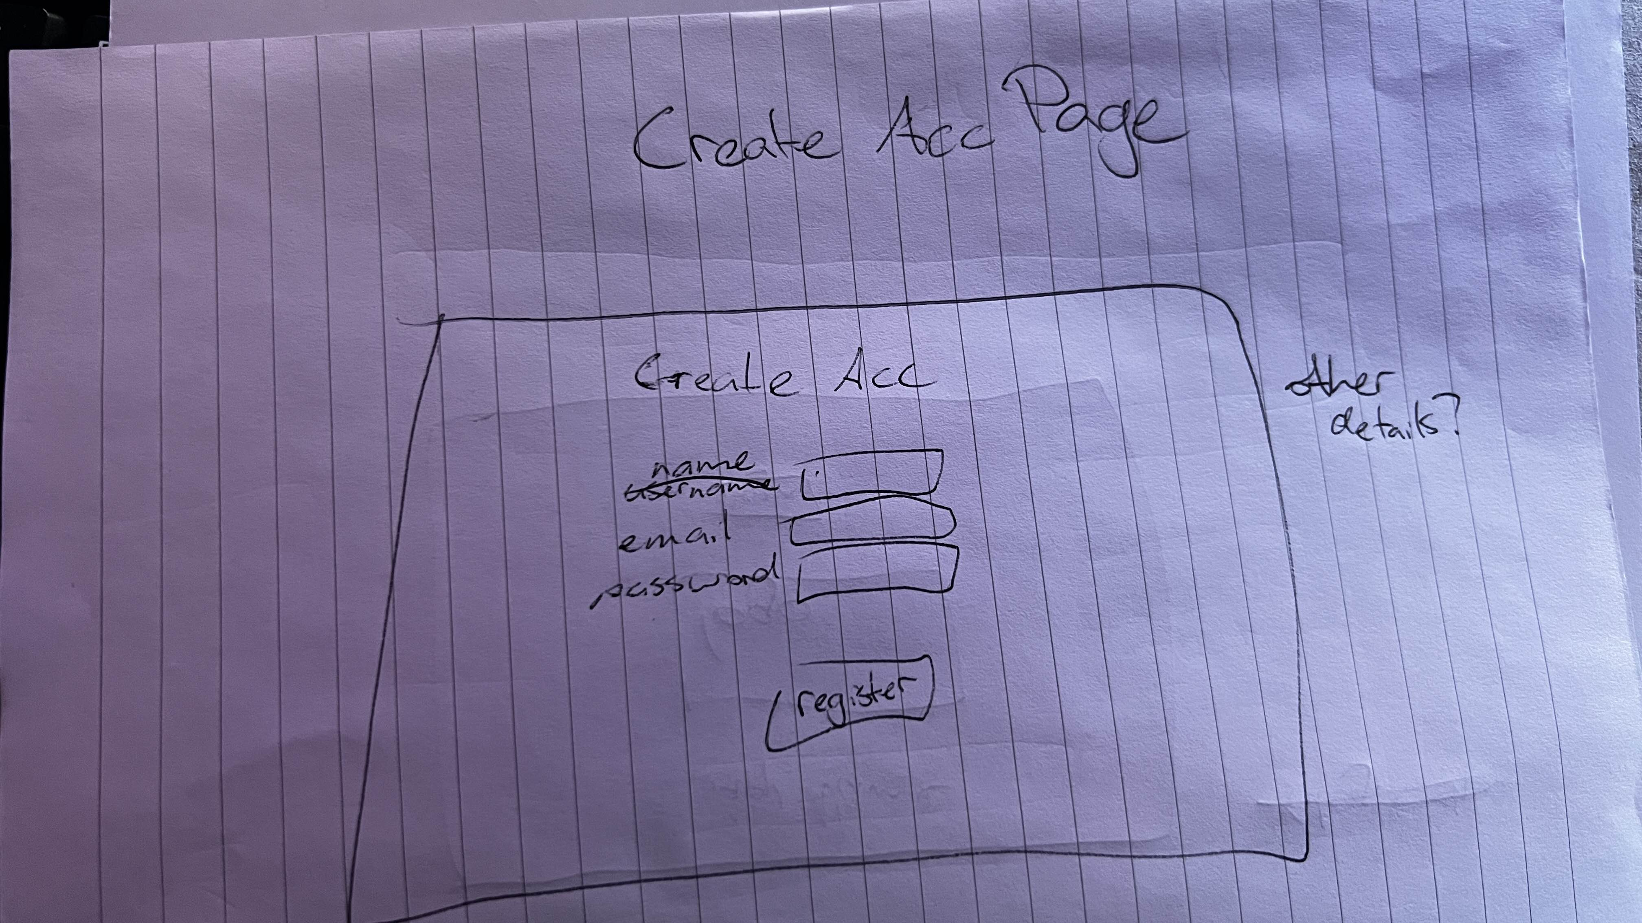
Low fidelity

Slide 6
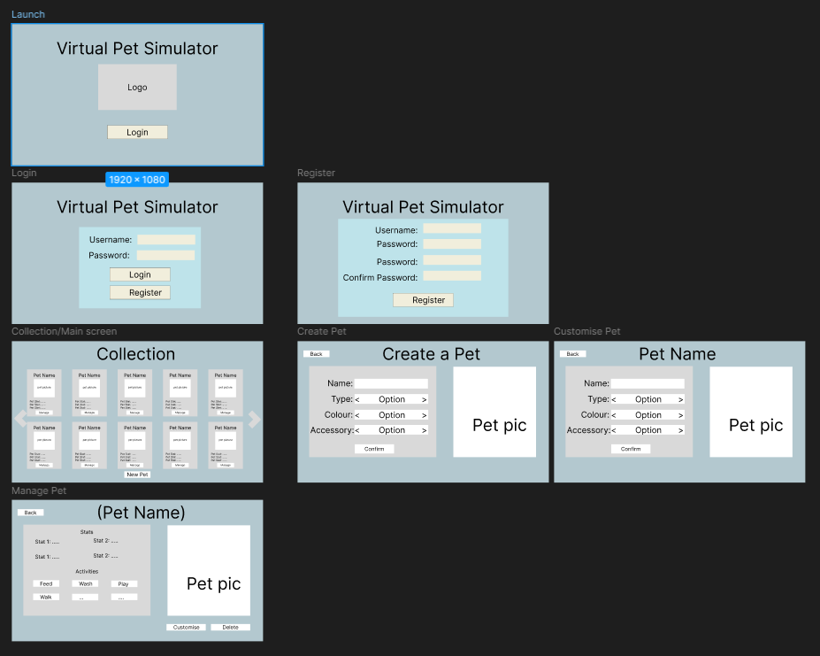
Medium Fidelity

Slide 7
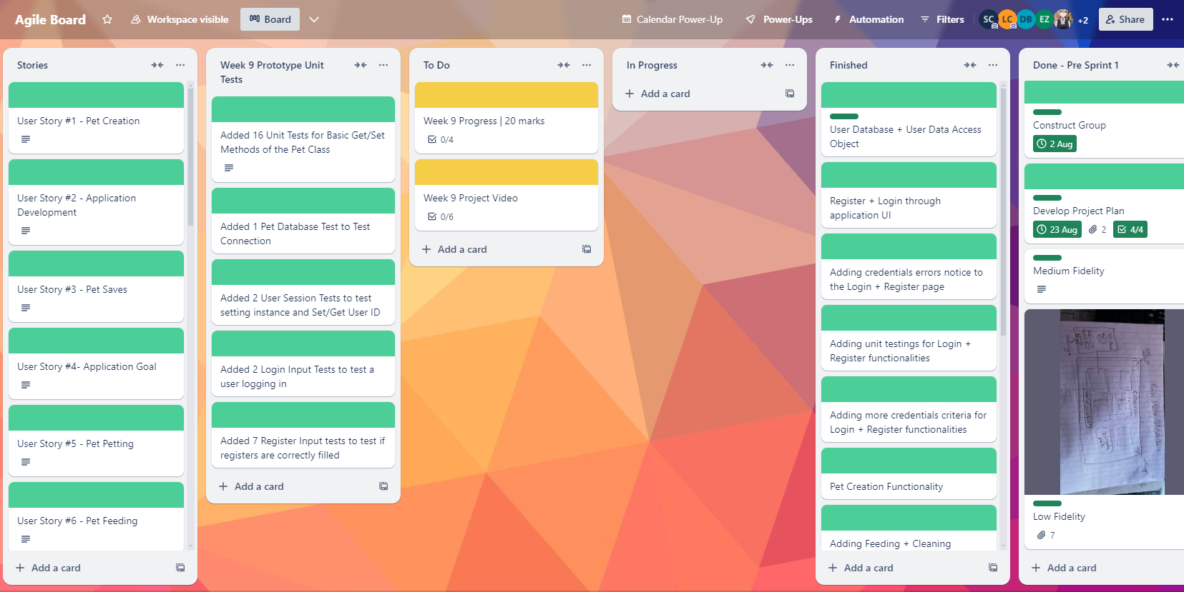
Project Management Tool
https://trello.com/b/7k3iZmGE

Slide 8
Github Usage
Each person making any major changes utilised branches so as to maintain functional versions of code.
Code was regularly merged to reduce conflicts
Advance communication between team members to reduce conflicts

Slide 9
JavaFX Code Summary
Follows Model-View-Controller pattern
with controllers managing FXML-based views
Core screens:
Launch view, login view, register view, collection view, pet creation view, pet interaction view, other+
Design & Styling
Consistent color scheme, modern UI elements, visual effects for buttons and grids
Navigation:
Scene transitions using FXMLLoader for seamless UI flow

Slide 10
Database persistence code summary
General Approach
User management
Pet Management
Separation of concerns
Separation between data access (DAO), business logic (managers), and database connection handling
Secure operations
Prepared statements for secure database queries, preventing SQL injection attacks
Design Patterns
Singleton design pattern for managing database connections, controlled access to database resources
User database persistence:
User data is stored in SQLite database
Data Access Layer
Implements CRUD operations
Authentication and verification
Singleton Database Connection
Ensures singleton connection instance for efficient resource usage
Pet data persistence:
Pet data stored in SQLite database
Advanced data operations
Provides CRUD operations
Data Access Layer
Uses interface-driven approach to separate data operations from business logic, ensuring modularity and flexibility.

Slide 11
Unit tests code summary
Setup
Use @BeforeEach for initialising common components before each test
Validation
Check for field completeness, input correctness, and existing entries
Assertions
Use assertions to confirm expected behaviour, like assertTrue and assertFalse
Database Interaction
Test adding, checking, and deleting data to validate the database functionality
Input scenarios
Verify behaviour for valid and invalid inputs, matching passwords, and readiness of inputs

Slide 12
Code demonstration

